Slide 1
Research and Design
Software Design Patterns: Element 1
Name: Daniel Cyril Obon
Student ID: C2650218

Slide 2
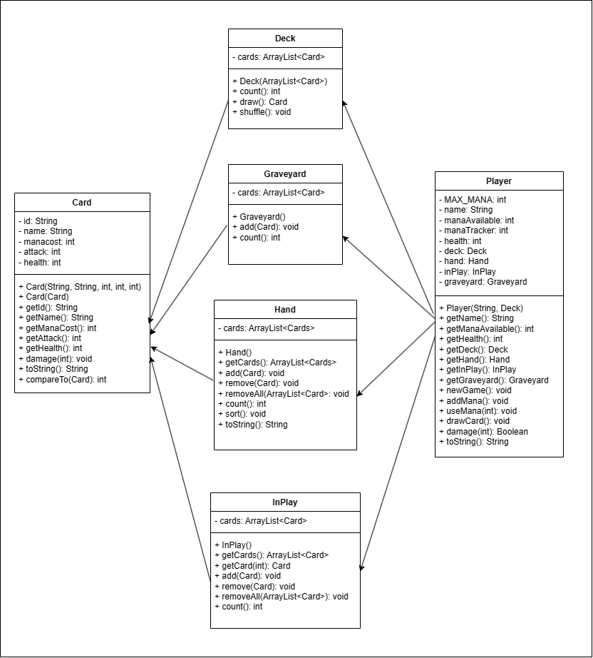
Base UML
Limited Extensibility: Difficult to accommodate new types of cards such as spells
Violation of Open/Closed Principle: Software entities should be open for extension but closed for modification
Poor Encapsulation: Behaviour such as taking damage and comparing cards is directly implemented within the class itself, making the behaviour tightly coupled.

Slide 3
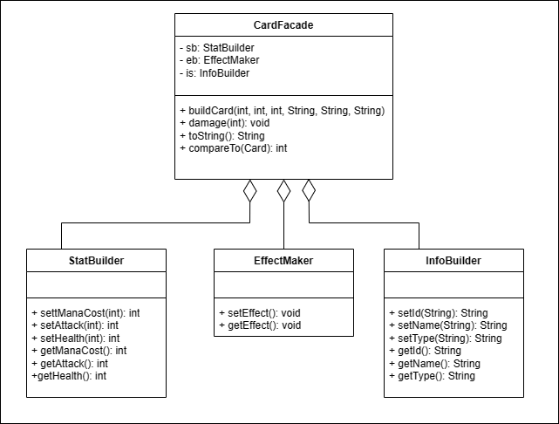
Façade Pattern
Advantage
Simplified Interface: Encapsulates interaction and dependencies of Card class.
Enhanced Reusability: Provides a single point for accessing the functionality of Card class.
Disadvantage
Limited Flexibility: Fixed interface that exposes only a subset of the functionality due to additional abstraction.
Potential Overhead: Can introduce overhead in terms of performance and complexity.
Increased Coupling: Coupling between Façade and subsystems it encapsulates.

Slide 4
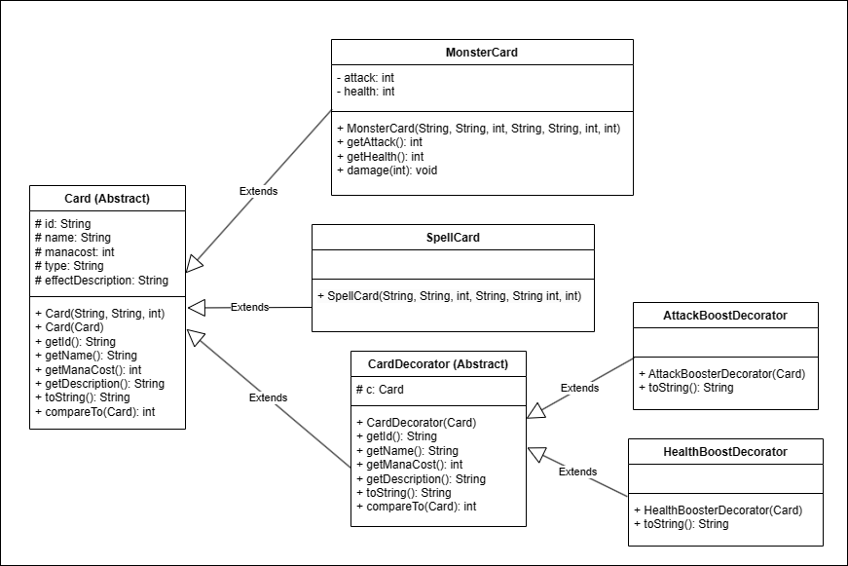
Decorator Pattern
Advantage
Incremental Development: New decorators could be added gradually as new requirements arise.
Dynamic Extensibility: Provides a flexible and incremental approach to extending Card class.
Disadvantage
Increased Complexity: Deals with many decorators and complex interactions between decorators.
Maintaining Consistency: May be difficult to ensure consistency between shared states or interactions.

Slide 5
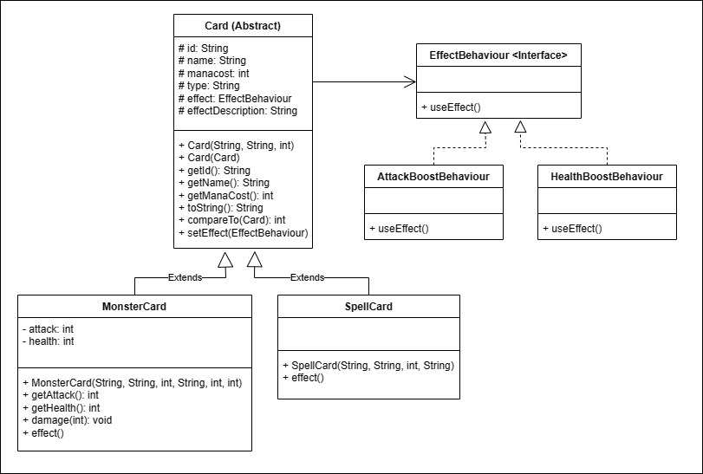
Strategy Pattern
Advantage
Flexible Behaviour: Allows different behaviours such as attack, defend or abilities to be encapsulated.
Open/Closed Principle Compliance: New classes can be introduced to represent additional behaviour without changing previous code.
Disadvantage
Increased Complexity: Involved defining multiple strategy classes and managing interactions between them.
Potential Performance Overhead: Due to its dynamic nature and delegation behaviour to strategy objects.

Slide 6
Unsuitable use of Decorator and Facade
Reason not to use Façade:
May provide a simplified interface, however, is less suitable for scenarios which require dynamic modification of individual card behaviours. Focuses on high-level interface over dynamic code.
Reason not to use Decorator:
While allowing dynamic modification, might introduce complexity in managing decorators and ensuring consistency of state across multiple decorators.

Slide 7
Conclusion: Strategy Pattern is Recommended
Reason to use Strategy:
Allows for clients to select and switch between different behaviours at runtime.
Suitable for scenarios where Card class exhibits different behaviours and strategies.
Reduced coupling of behaviour objects from their implementation, reducing dependencies.
Promotes code reusability by encapsulating behaviours as strategy objects which can be shared across other context.

